Slide 1
Construction
Studies

Slide 2
Introduction
Construction Studies Practical Coursework must consist of
A report on the development and realisation of the project.
A completed artefact.
A report on three experiments undertaken.
Further information on the requirements of project work is available from
Instruction to Candidates m77p issued to all candidates each year by the SEC
Chief Examiner’s Reports on Construction Studies

Slide 3
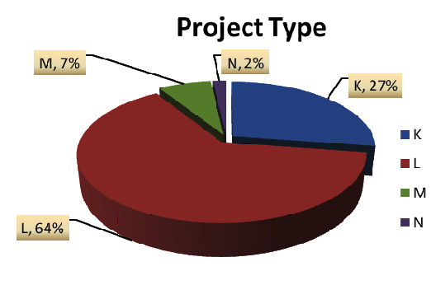
Project Selection
Project Selection—Initial Tasks—Focus of Project—Project Development—Design of Artefact—Manufacture of Artefact—Experiments—Evaluation—Role of Class Teacher
Once the start date and duration of project work has been finalised the next task is to explore the possible options with students.
Project Types
Construction (K)
Furniture (L)
Heritage (M)
New Technologies (N)
What are the attributes of each project type in relation to the other components of the construction studies syllabus?
Notes:
So why

Slide 4
Initial Tasks
Project Selection—Initial Tasks—Focus of Project—Project Development—Design of Artefact—Manufacture of Artefact—Experiments—Evaluation—Role of Class Teacher
Students should select a project type that will engage them and match
their skills and abilities
Project must be agreed with the class teacher
It is important that students undertake some general research on their chosen
project type/area before deciding on a specific project.
Formulate a project brief/aims/statement that will describe what the student
proposes to achieve.
Engage in a range of research activities primary and secondary, that are relevant to
the selected project. The information gathered should be evaluated and presented
in the design folio. Students should explain why the information has been included
and illicit links with the aim/goal of their project.

Slide 5
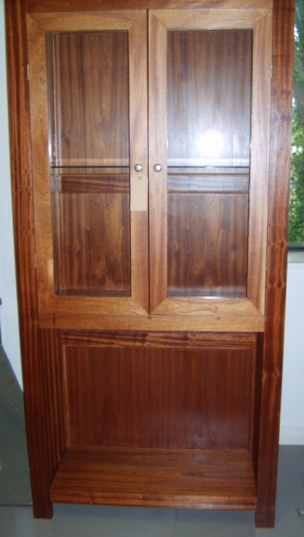
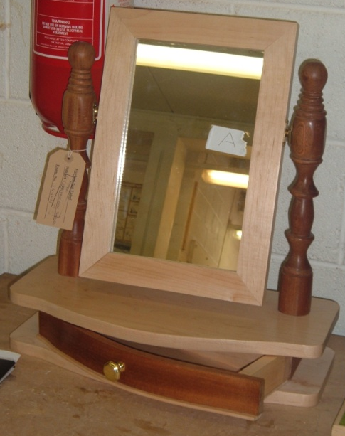
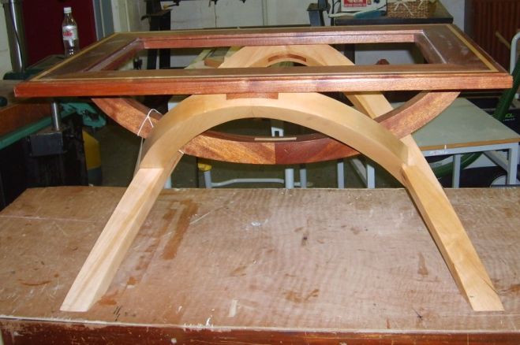
Focus of Projects
Project Selection—Initial Tasks—Focus of Project—Project Development—Design of Artefact—Manufacture of Artefact—Experiments—Evaluation—Role of Class Teacher
Furniture
Should be directed by aims/statement or brief
Involve meaningful research and a genuine attempt to develop a unique design
Challenge students skills and abilities
Small scale well designed rather than large minimal artefacts

Slide 6
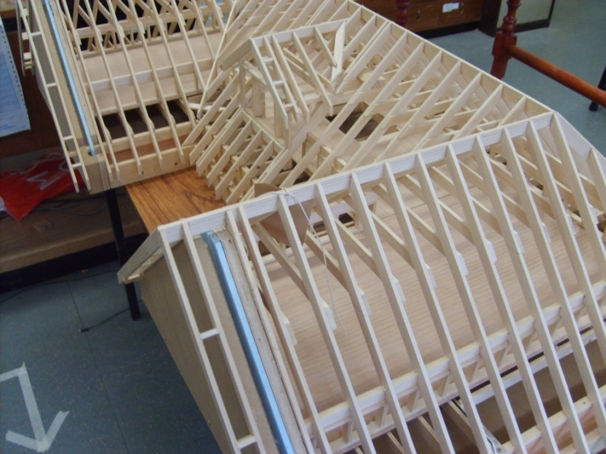
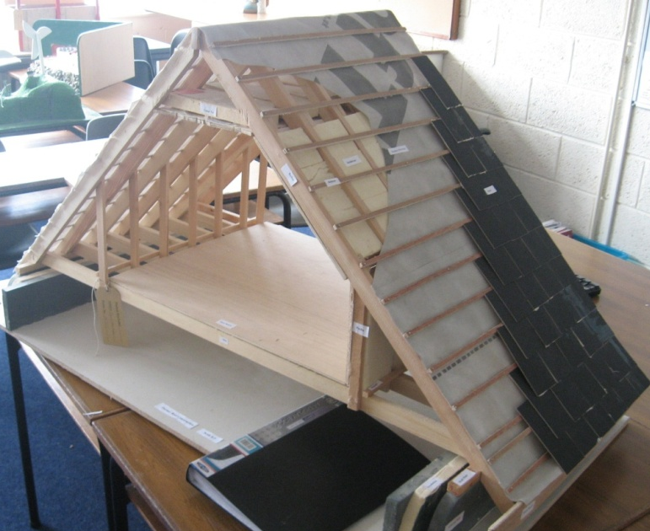
Focus of Projects
Project Selection—Initial Tasks—Focus of Project—Project Development—Design of Artefact—Manufacture of Artefact—Experiments—Evaluation—Role of Class Teacher
Construction
Should be directed by aims/statement or brief
Research must be relevant to focus of project
Artefact should support outcomes of research
Artefact must be of an appropriate scale, technically correct, labeled
and presented well
Consider size of artefact – bigger is not necessarily better

Slide 7
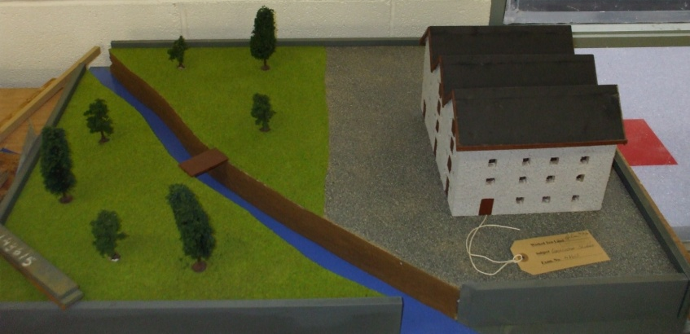
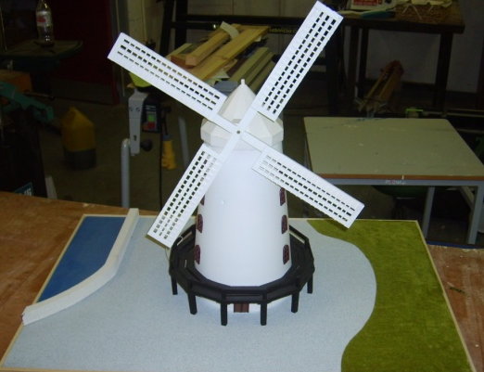
Focus of Projects
Project Selection—Initial Tasks—Focus of Project—Project Development—Design of Artefact—Manufacture of Artefact—Experiments—Evaluation—Role of Class Teacher
Heritage
Should be directed by aims/statement or brief
Research should focus on details of building/artefact rather than people who used/lived in it
Should ideally involve visit to building/artefact where details are observed photographed, measured and recorded.
Model is usually a reproduction of part or all of the building/artefact, this must be representative, to an appropriate scale and presented well.

Slide 8
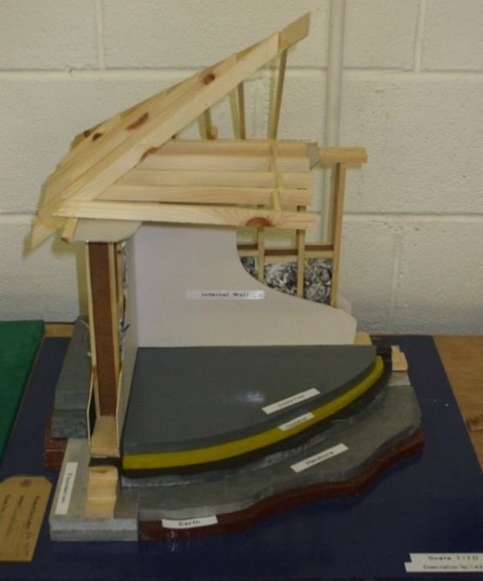
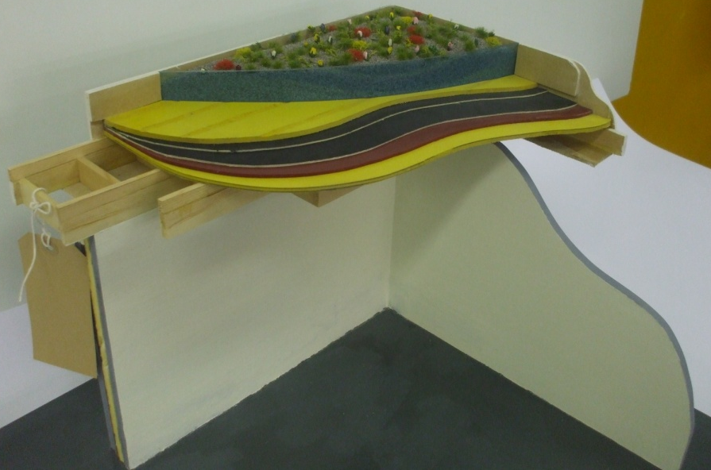
Focus of Projects
Project Selection—Initial Tasks—Focus of Project—Project Development—Design of Artefact—Manufacture of Artefact—Experiments—Evaluation—Role of Class Teacher
New Technologies
Should be directed by aims/statement or brief
Research must be relevant to focus of project
Artefact should support outcomes of research
Artefact must be of an appropriate scale and technically correct, labeled and well presented

Slide 9
Project Development
Project Selection—Initial Tasks—Focus of Project—Project Development—Design of Artefact—Manufacture of Artefact—Experiments—Evaluation—Role of Class Teacher
Task:
The following statements represent students aspirations for their coursework. These have been formulated after some initial research by them.
You are requested to develop a set of instructions for the student that will ensure a comprehensive range of relevant information for inclusion in the folio is provided. These instructions should identify the key decisions that must be taken before the student can progress to developing a design.
Construction
I would like to determine a foundation system that is suitable for the soil type in my locality and also meets the passive house standard.
Furniture
Design and make a contemporary coffee table that will compliment the existing décor in my parents living room.

Slide 10
Project Development
Project Selection—Initial Tasks—Focus of Project—Project Development—Design of Artefact—Manufacture of Artefact—Experiments—Evaluation—Role of Class Teacher
Heritage
The purpose of my project is to examine the influence of socio-economic background on vernacular architecture in my locality and identify its key characteristics.
New Technologies
Solar panels offer a reasonably inexpensive and sustainable method of providing hot water for my parents house. However, as the roof surfaces of our rectangular shaped bungalow are orientated east – west, I would like to determine the most cost effective and visually attractive method of incorporating them in the structure of the building

Slide 11
Design of Artefact
Project Selection—Initial Tasks—Focus of Project—Project Development—Design of Artefact—Manufacture of Artefact—Experiments—Evaluation—Role of Class Teacher
The knowledge and conclusions established from research are paramount in developing a design for the artefact or item of furniture.
The thought process of the student must be evident throughout
Designs should be developed through neat well proportioned sketches
Details of Artefact
All aspects of the finished artefact, such as materials, jointing techniques finishes scale etc should be considered and selected at this stage.
Scaled or full sized working drawing should be produced
All information necessary to produce the artefact must be finalised and recorded in this section of the folio.

Slide 12
Manufacture of Artefact
Project Selection—Initial Tasks—Focus of Project—Project Development—Design of Artefact—Manufacture of Artefact—Experiments—Evaluation—Role of Class Teacher
Planning is vital to ensure a quality finished artefact
Students should evaluate the design regularly and revise where necessary
Students should endeavor to describe the processing of the artefact in a manner that illustrates clearly the key stages involved and critical decisions taken throughout. This should be achieved using photographs/sketches with explanatory notes.
Sketches 3D
Sketches 2D

Slide 13
Experiments
Project Selection—Initial Tasks—Focus of Project—Project Development—Design of Artefact—Manufacture of Artefact—Experiments—Evaluation—Role of Class Teacher
Three experiments must be carried out by each student individually
It is recommended that the experiments should be related to the coursework and their conclusions used to enhance the response to the project brief or aim.
Experiments must be recorded in a distinct section of the folio.
Evidence that the experiments were completed by the student must be included in the folio - photographs, unique results and sketches.
Each experiment must have a clearly stated objective, a description of how it was carried out, scientifically evaluated results and a conclusion which relates the findings to the coursework or general construction practice.
“Group or class experiments do not comply with the recommendations of the SEC.” Chief Examiners Report 2009

Slide 14
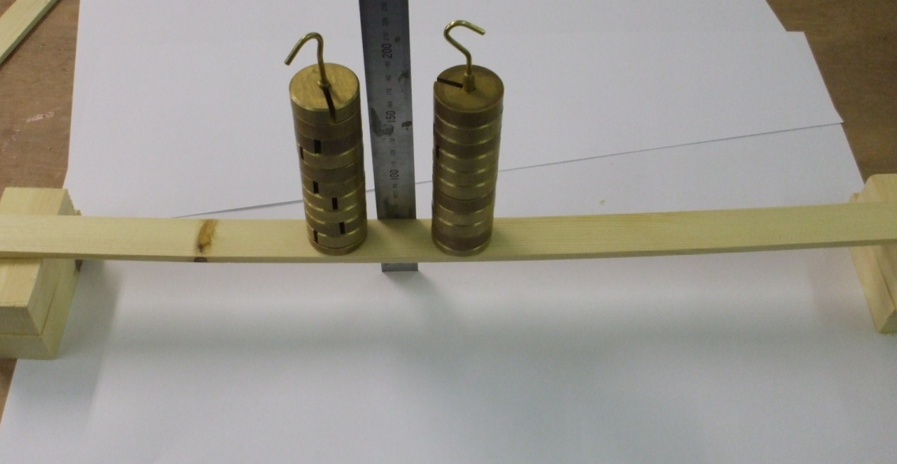
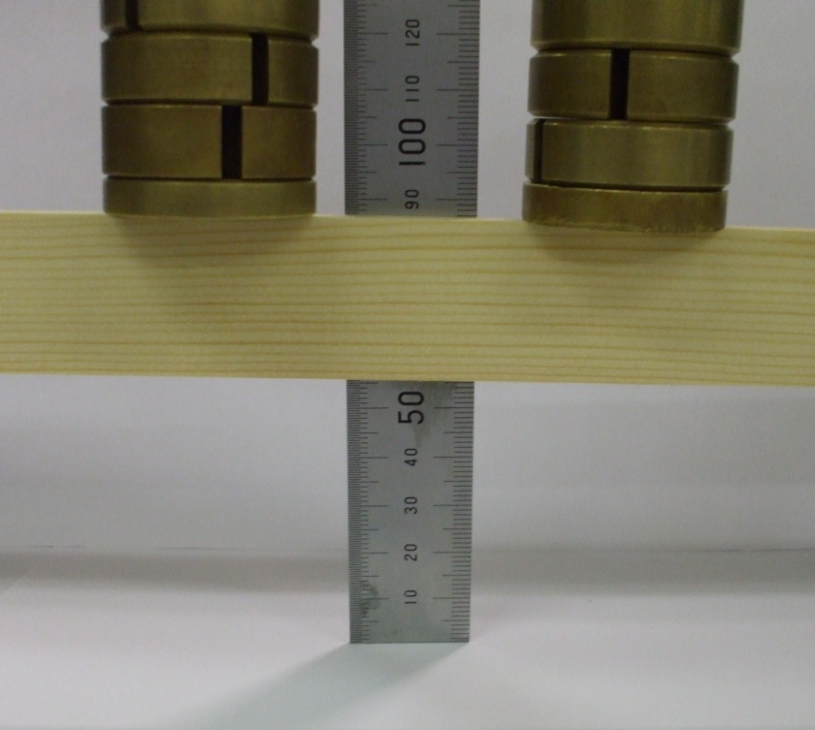
Experiments
Project Selection—Initial Tasks—Focus of Project—Project Development—Design of Artefact—Manufacture of Artefact—Experiments—Evaluation—Role of Class Teacher

Slide 15
Evaluation
Project Selection—Initial Tasks—Focus of Project—Project Development—Design of Artefact—Manufacture of Artefact—Experiments—Evaluation—Role of Class Teacher
Evaluating the coursework
Critically analysing a body of work, particularly a students own work can be a difficult task. It is essential however, that students reflect on their achievement and analyse their participation in order to maximise the personal and educational benefit of coursework.
Students should review their coursework considering each of the following
Aims/goals/brief
Specific areas of the coursework
Focus on the artefact
Students own performance
Recommended modifications should also be identified

Slide 16
Role of the Teacher
Project Selection—Initial Tasks—Focus of Project—Project Development—Design of Artefact—Manufacture of Artefact—Experiments—Evaluation—Role of Class Teacher
Role of the Class Teacher
“The role of the teacher in both the supervision and authentication of candidate work is the key to guaranteeing the integrity of coursework submitted for assessment.” Chief Examiner’s Report 2009
Teachers can ensure they uphold the integrity of coursework by:
Distributing the regulations (m77p) issued to candidates each year by the SEC
Ensuring their students understand each of the regulations listed, particularly that the coursework must be completed in school under their supervision and may not be removed from the school setting.
Highlighting any change to the regulations from previous years.

Slide 17
Role of the Teacher
Project Selection—Initial Tasks—Focus of Project—Project Development—Design of Artefact—Manufacture of Artefact—Experiments—Evaluation—Role of Class Teacher
Enforcing the regulations and not validating the work of students that does not comply with the regulations.
Informing their students of the consequences of not complying with the regulations.
“a total of twenty two candidates (0.24%) were not awarded any marks for the coursework component of Construction Studies in 2009.” Chief Examiner’s Report 2009.

